Slide 1
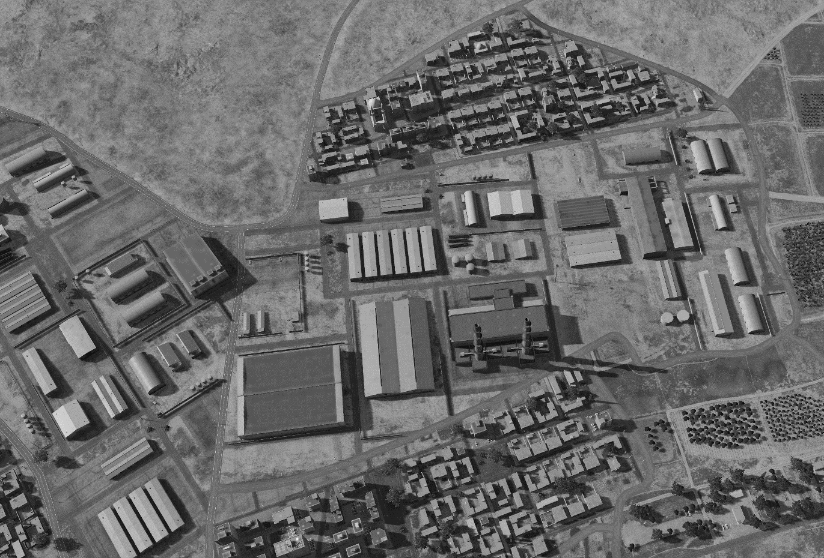
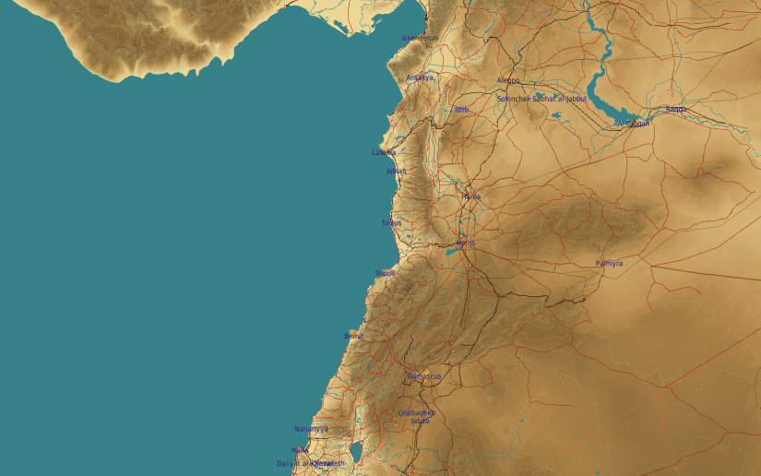
OPARTGT009 DAMASCUS N AMMUNITION FACTORY
N
12
8
9
10
09
6
7
13
5
DESIRED POINT of IMPACT:
Assembly Buildings
DPI 12 - N33 34.004 E 36 20.147 / 2463ft/ 2000lb PGM
DPI 10 - N33 33.956 E 36 20.094 / 2470ft/ 2000lb PGM
DPI 9 - N33 33.967 E 36 19.997 / 2500ft/ 2000lb PGM
DPI 8 - N33 33.960 E 36 19.873 / 2512ft/ 2000lb PGM
DPI 7 - N33 33.934 E 36 19.931 / 2512ft/ 2000lb PGM
DPI 6 - N33 33.932 E 36 19.899 / 2520ft/ 2000lb PGM
DPI 5 - N33 33.890 E 36 19.988 / 2485ft/ 2000lb PGM
Assembly Building
DPI 4 - N33 33.877 E 36 19.931 / 2495ft/ 2000lb PGM
DPI 3 - N33 33.874 E 36 19.911 / 2500ft/ 2000lb PGM
DPI 2 - N33 33.856 E 36 19.837 / 2500ft/ 2000lb PGM
DPI 1 - N33 33.838 E 36 19.857 / 2500ft/ 2000lb PGM
3
4
2
1
CDC - Civilian housing within 100m N and S of facility. Religiously significant building 200m N of facility boundary.

